Slide 1
Mini-BlockChain Transaction System
Made by: Tirth Mehta D19DIT087

Slide 2
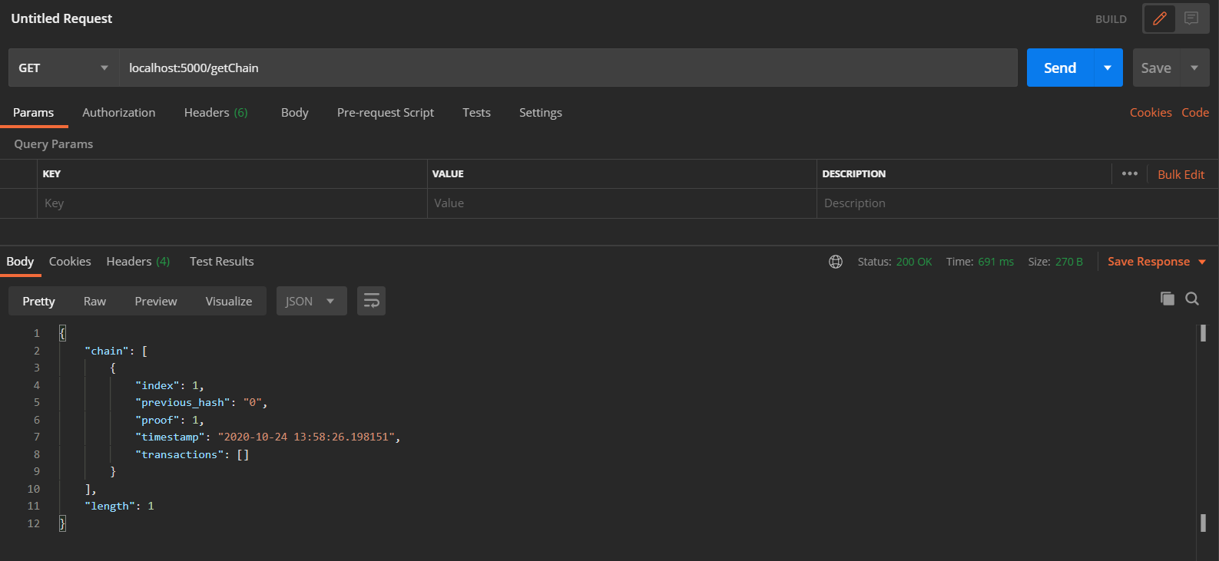
Creating the blockchain

Slide 3
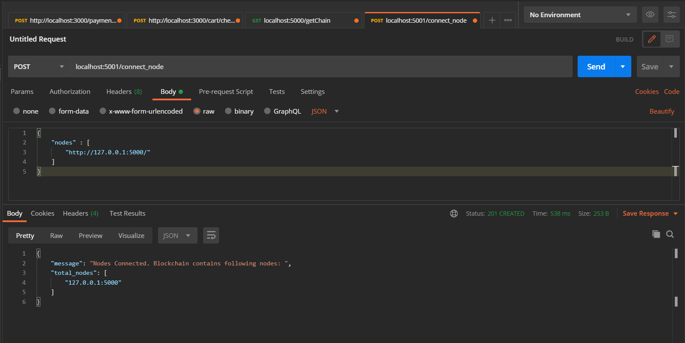
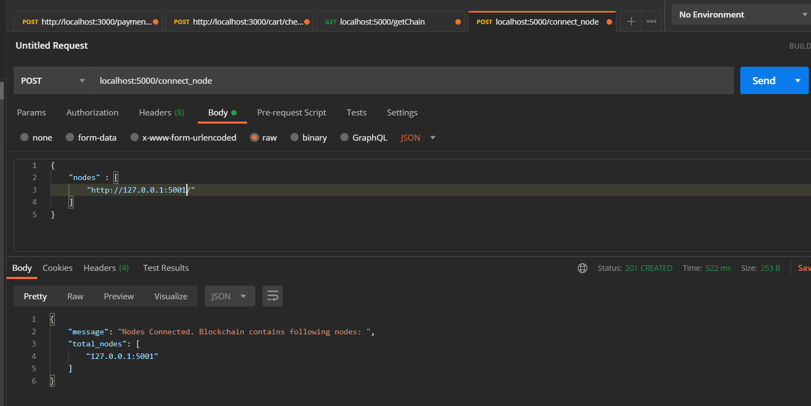
Connecting Nodes

Slide 4
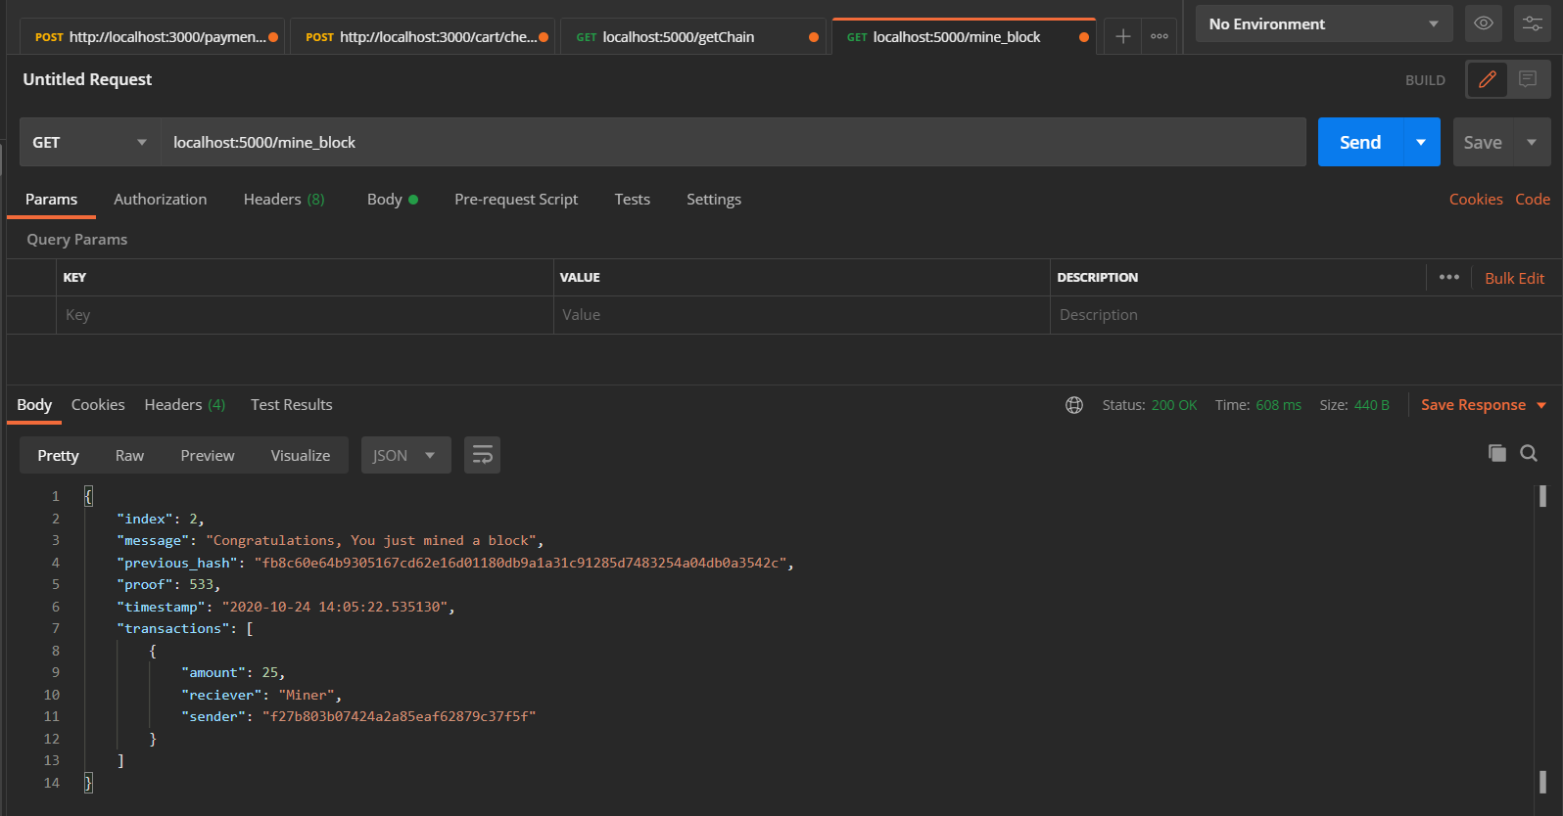
Mining a block on 5000

Slide 5
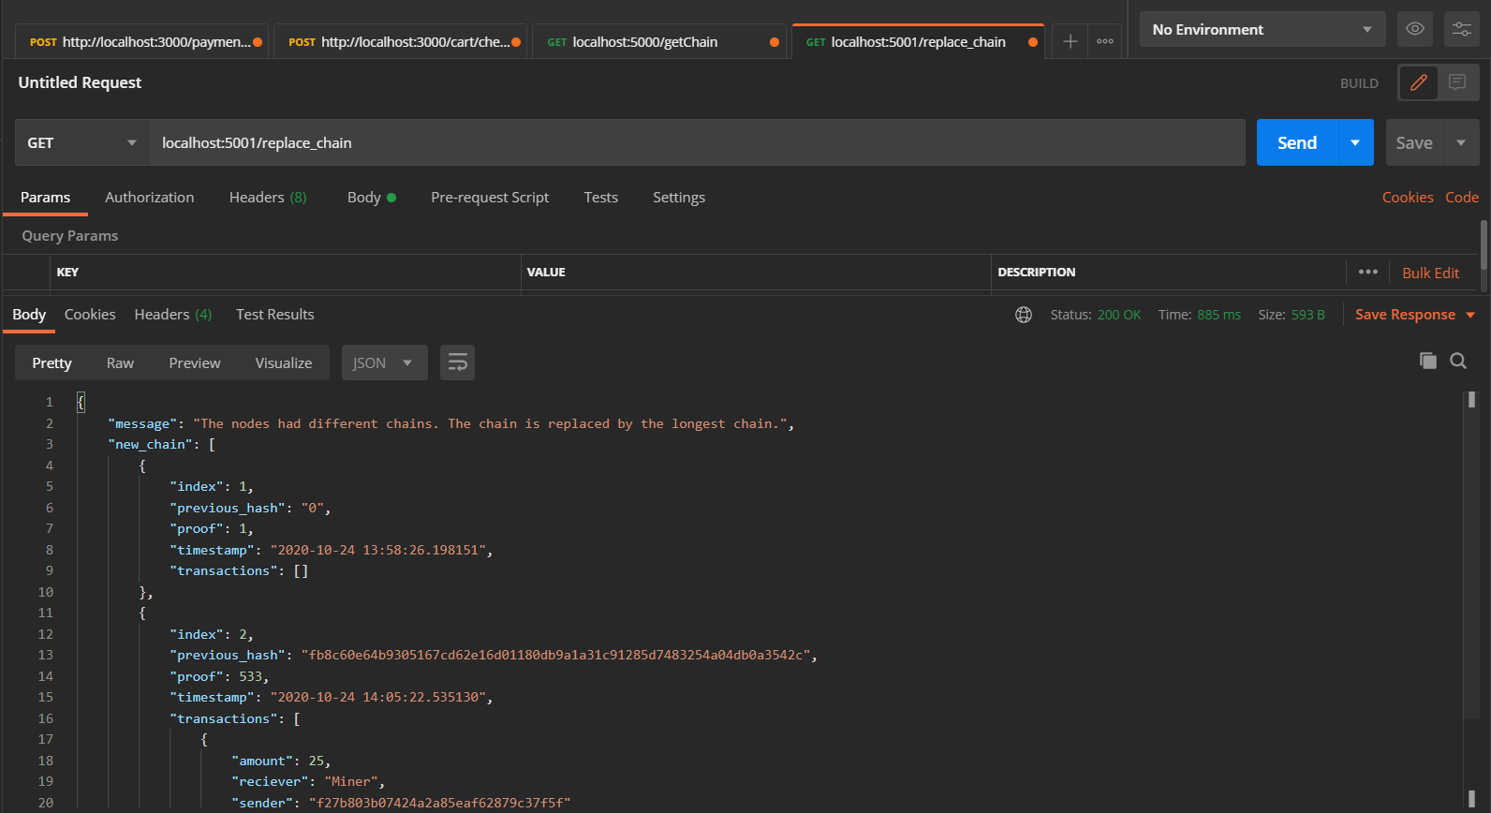
Verifying the block across nodes

Slide 6
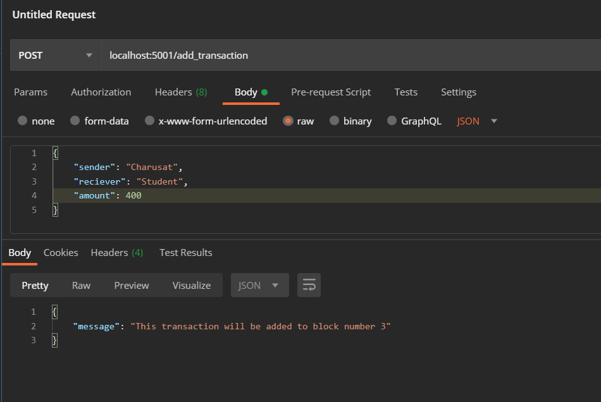
Adding Transaction

Slide 7
Thank You

